Slide 1
Event Planning
Web-based Application
WebIt: Krishna Viradia, Courtney Burns, Sara Nazir, Wubnyonga Tete, Theresa Tomilson, Mehak Uddin, Nuri Ousman

Slide 2
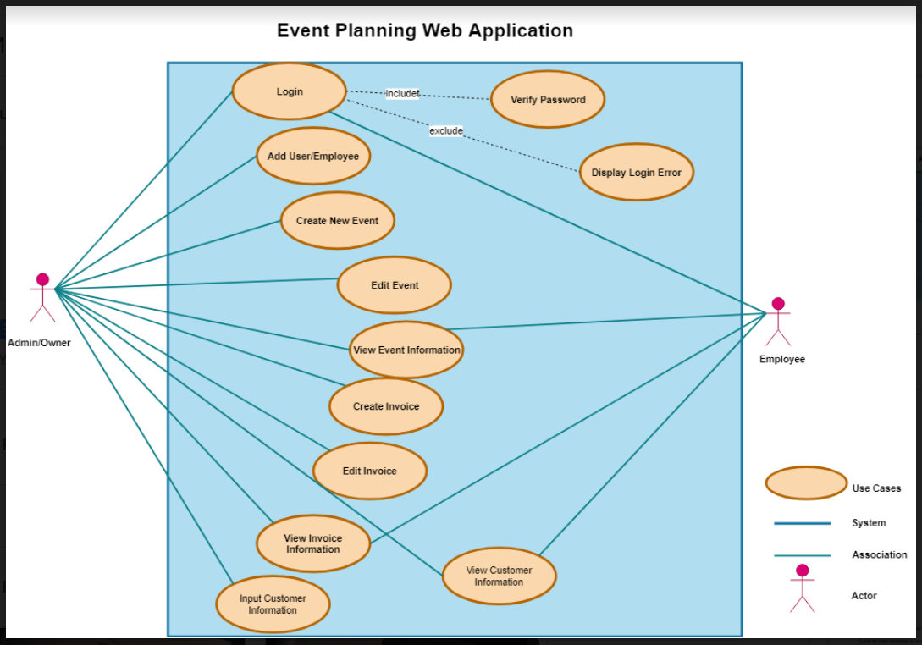
Revising Deliverable 2 Use Case diagram
Deliverable 2 use case
Notes:
Tete

Slide 3
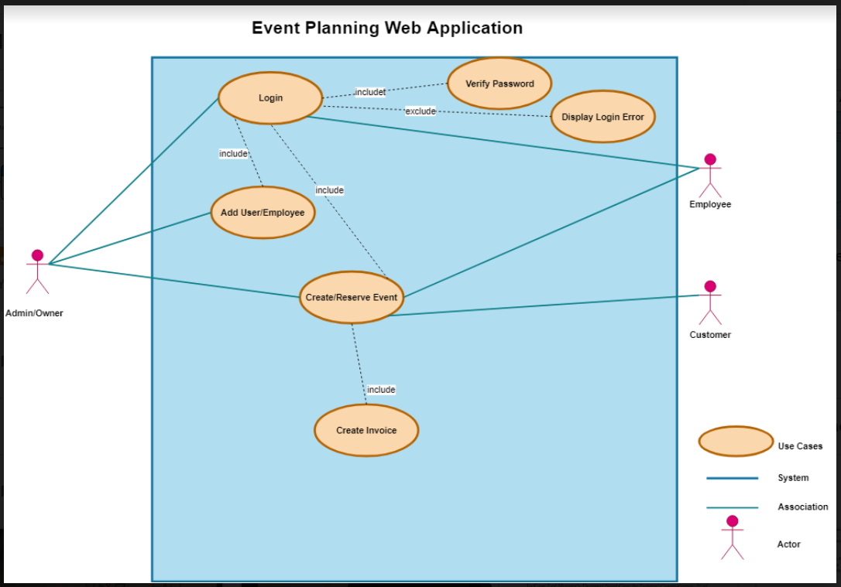
Revising Deliverable 2 Use Case diagram
New use case diagram
Notes:
Tete

Slide 4
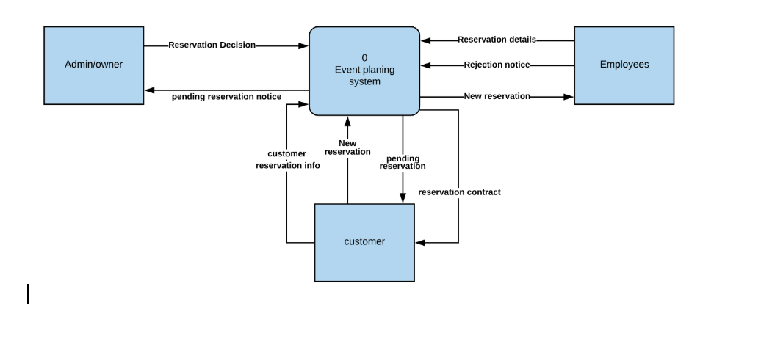
Context Diagram
Notes:
Tete

Slide 5
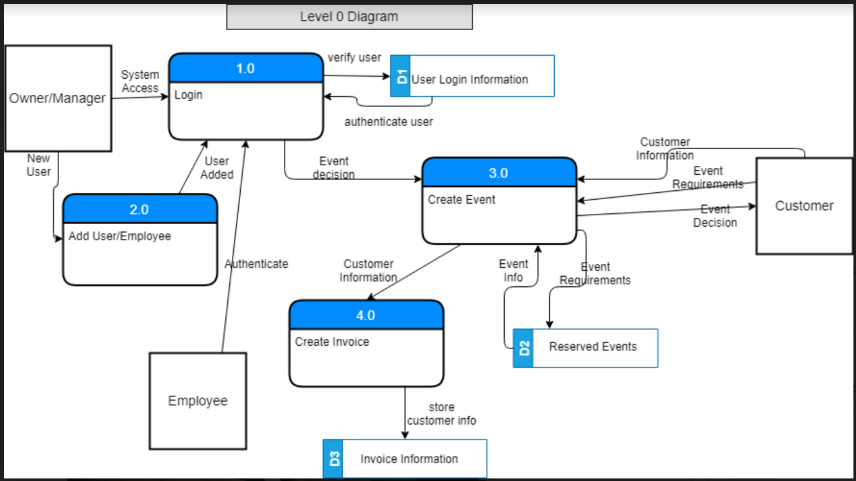
Level 0 Diagram
Notes:
Courtney

Slide 6
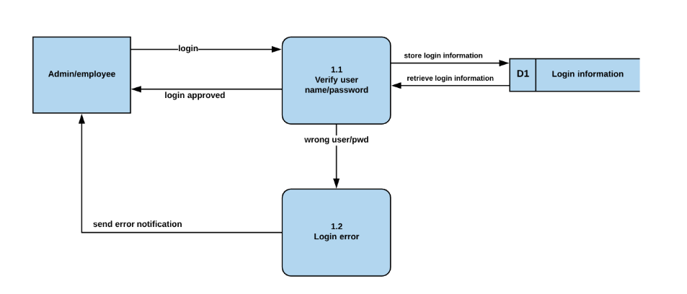
Process 1(login) -Level 1 Diagram
Notes:
Courtney

Slide 7
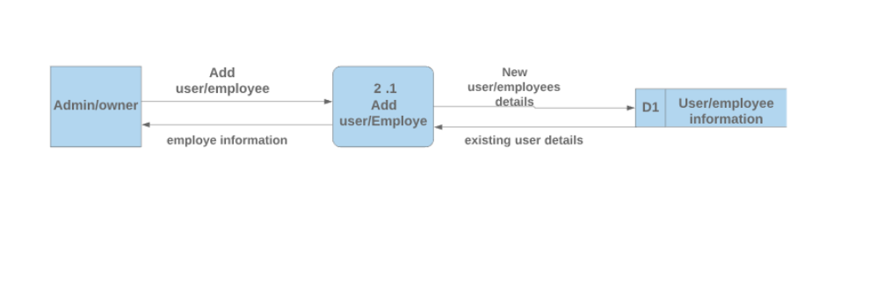
Process 2(Add user/employee) - Level 1 Diagram

Slide 8
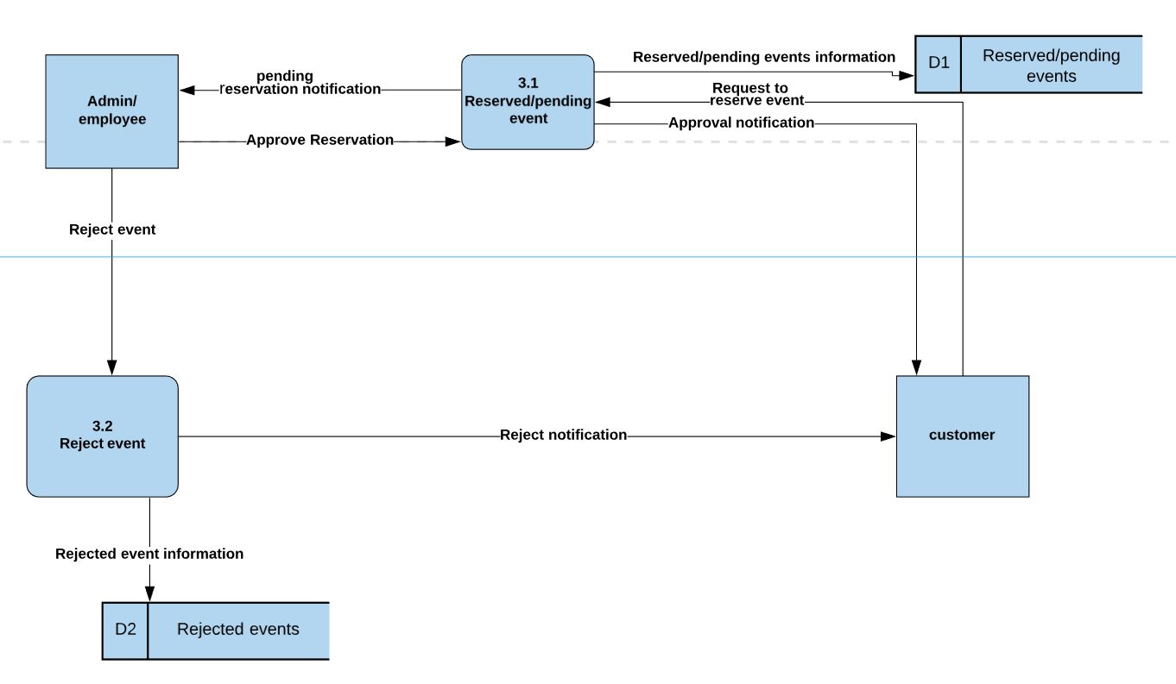
Process 3(create event) - Level 1 Diagram
Notes:
Nuri

Slide 9
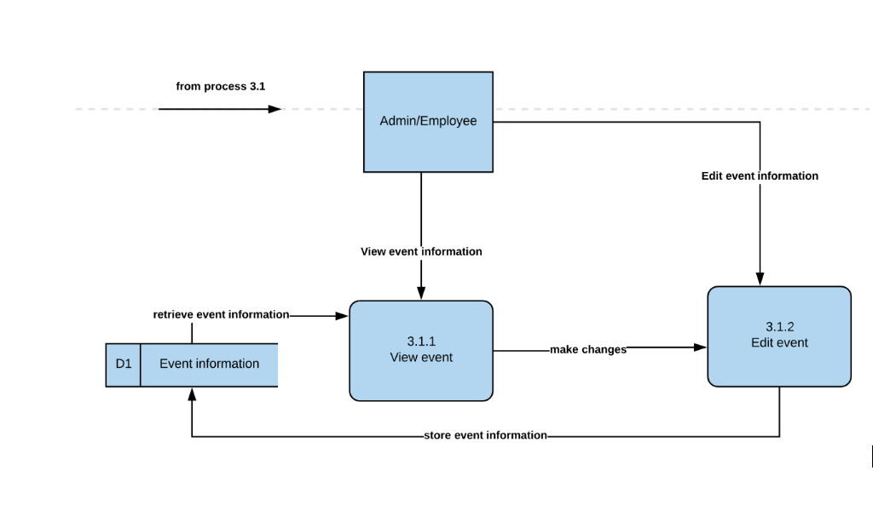
Process 3.1- Level 2 Diagram
Notes:
Nuri

Slide 10
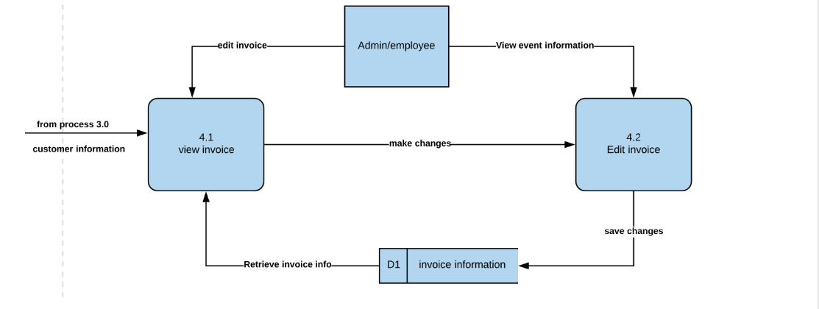
Process 4 (create invoice)- Level 1 Diagram
View event information
Edit invoice

Slide 11
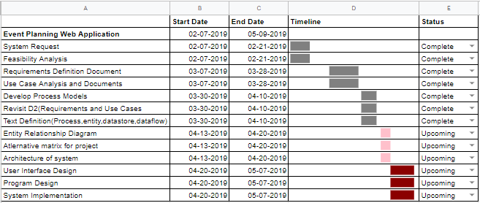
Gantt Chart
Notes:
All of us

Slide 12
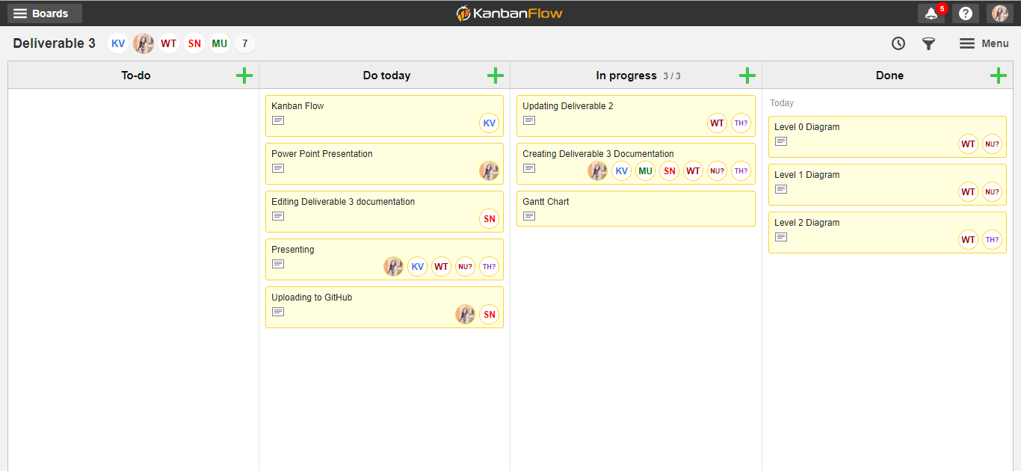
Kanban Flow
Notes:
All of us

Slide 13

Questions??

